Slide 1

A
synopsis on
KLNAV-Way to Life
Submitted by
Group. No.
Abhinav Tyagi- 2100290140003
Vaibhav Sinha- 2100290140142
Submitted to
Department of Computer Application,
KIET Group of Institutions,
Delhi-NCR, Ghaziabad
Under the Supervision of
Mr. Ankit Verma
(Ass. Professor)

Slide 2
CONTENTS:
INTRODUCTION
TECHNOLOGIES
MODULES
WHAT’S NEED OF IT
OUTCOME
HOW WE SERVE THE SOCIETY
GANTT CHART

Slide 3
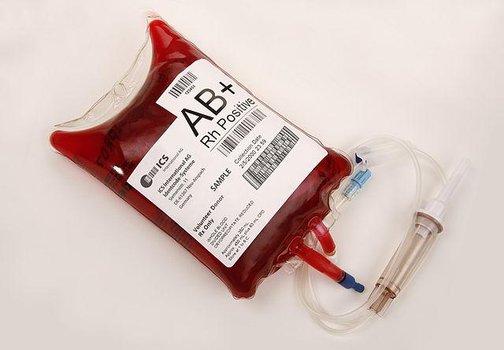
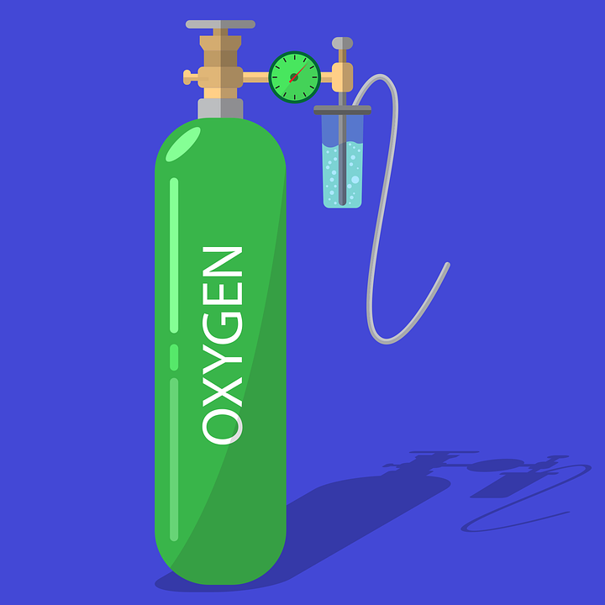

INTRODUCTION:
We are making a website where any person can find any type of :
BLOOD
PLASMA
PLATELETS
&
OXYGEN CYLINDERS by just Single TAP.
Just filtering the State ,City and Blood Type or Oxygen cylinder.
User got the list of nearest blood bank and oxygen provider with availability of particular search.
User could directly contact with them and ask for the requirement.
Blood or Oxygen provider provide the requirement as soon as possible.

Slide 4







TECHNOLOGIES:

Slide 5
MODULES:
Items Listing
Search bar
Blood group
State/City
Review & Feedback

Slide 6
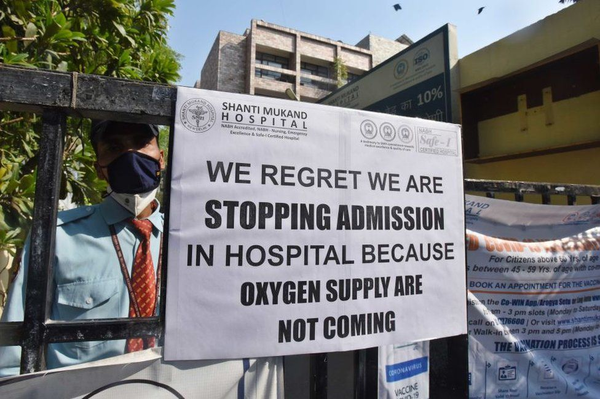
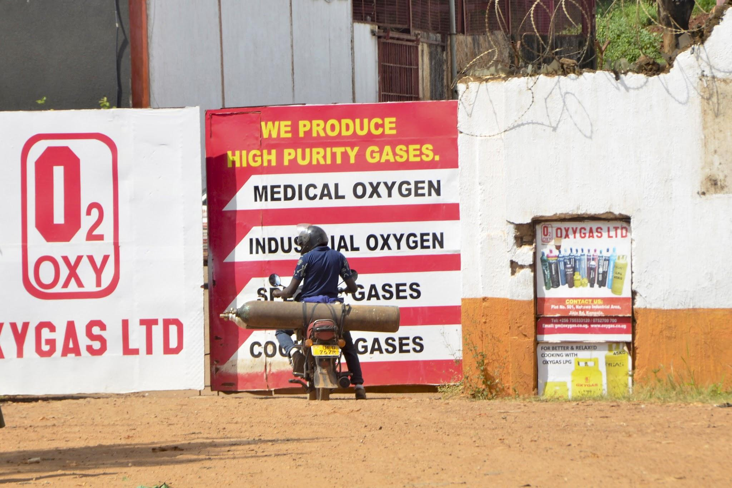
WHAT’S NEED OF IT ?
India is a vast country and here, in every two seconds somebody needs blood. In many cases, people lose their lives because of lack of blood.
The main reason behind the shortage of blood many times it happens that the needy who wants blood does not get blood anywhere and the bank who is having blood is not able to communicate with that patient, due to this the patient also suffers and keeping the blood also gets expired
Last year we all have seen that India is gasping for oxygen in pandemic.
100+ people died in one hospital overnight due to lack of oxygen in Karnataka.
There is no particular place to check the availability of oxygen cylinder till now.

Slide 7
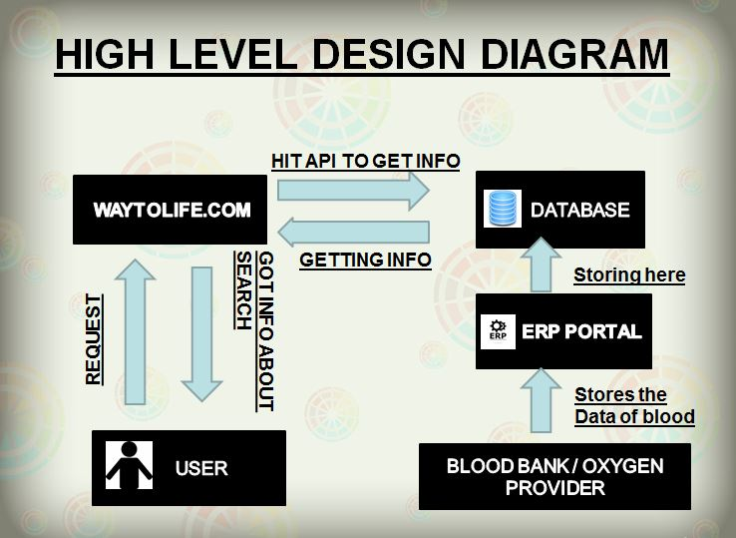
HIGH LEVEL DESIGN DIAGRAM:

Slide 8
OUTCOME:
A website will provide easy and convenient way to bridge the gap between Blood Banks or Oxygen Cylinder stores to the needy patients.It will save many lives as well as it saves shelf or stored blood which can’t be shelf more than 5 weeks.

Slide 9
HOW WEBSITE WILL SERVE THE SOCIETY?
This website will be providing a helpful platform for better tomorrow.
This platform will serve the society as instant life saver.
There is no website like this to solve this critical problem yet.
This website will help the society to deliver large amount of Oxygen cylinders and Blood packets.

Slide 10
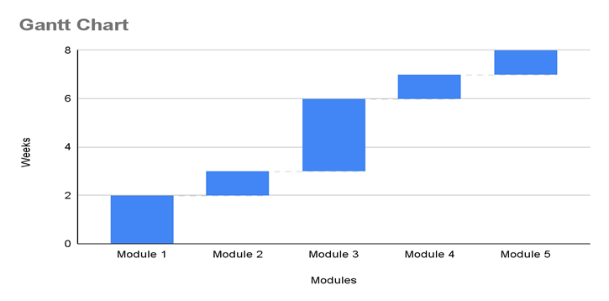
Gantt Chart:
Front end development (4-6Weeks)
Homepage
Website UI
Collection of Images
Database (3-4 Weeks)
Creating Table
Creating Data
Back end Development (2-3 Weeks)
Integration of database with website

Slide 11


